Slide 1
NSWRFS
COMMUNITY PROTECTION PLAN
Building Resilient Communities

Slide 2
Why Community Protection Plans
There is a need to integrate and standardise the format and content of plans developed at the community level.
There is also a need to provide guidelines, tools and resources to facilitate community level bush fire planning across the State.
2009 Victorian Bush Fire Royal Commission – Bush Fire Safety Policy Recommendations 1-5 of the final report are relevant.

Slide 3
Why Community Protection Plans
Recommendation 1 - Ensure that local solutions are tailored and known to communities through local bush fire planning…….Improve advice on the nature of fire and house defendability.
Recommendation 2 - Ensure that in content and delivery the program is flexible enough to engage individuals, households and communities and to accommodate their needs and circumstances.
Recommendation 3 - Undertake local planning that tailors bush fire safety options to the needs of individual communities.
Develop for communities at risk of bush fire, local plans that contain contingency options such as evacuation and shelter
Document facilities where vulnerable people are likely to be situated
Compile and maintain a list of vulnerable residents

Slide 4
Why Community Protection Plans
Recommendation 4 – Introduction of a comprehensive approach to shelter options.
Recommendation 5 – Introduction of a comprehensive approach to evacuation.
NSW Government Response to the Final Recommendations of the 2009 Victorian Bush Fires Royal Commission.
Particularly with regard to the Recommendation 3, made a commitment for the integration of Neighbourhood Safer Places, evacuation and community protection plans.

Slide 5
Purpose of Community Protection Plans
Aim:
To improve community and organisational capacity to deal with bush fires.
Objectives:
Clearly identify and depict contingency options available to a given community during a bush fire and evaluate their adequacy.
Increase the communities understanding of their bush fire risk and provide information that will assist in the preparation of personal bush fire survival plans.
Identify and depict the range and timing of treatments applied to a given community that are designed to reduce the bush fire risk and evaluate their adequacy.
Identify and register vulnerable facilities and vulnerable residents within a given community.
Gather and depict key information that will increase the preparedness of fire fighters for bush fire.

Slide 6
Who Will Prepare Community Protection Plans?
Community Protection Plans will be facilitated and prepared through the three Customer Service Centres (CSC).
CPP’s are plans of the Bush Fire Management Committee (BFMC’s) and will be prepared in consultation with BFMCs, LEMC’s, District Staff, Brigade members and the community.

Slide 7
Where Will Community Protection Plans be Applied?
Deciding where a Community Protection Plan will be developed will be guided by the BFRMP and consultations with members District staff and / or members of the BFMC.
Community Protection Plans are intended for human settlement areas that are:
Exposed to the greatest bush fire risk within a BFMC area.
Consideration should be given to risk and priorities designated in the BFRMP (e.g. 1A, 1B, 1C, 2A etc).
Areas where evacuation and shelter arrangements, or lack there of, present significant risks to life.
Areas where high concentrations of vulnerable people reside.

Slide 8
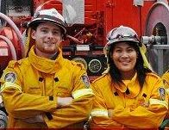
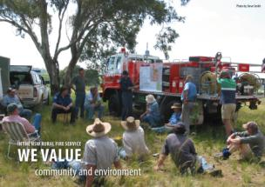
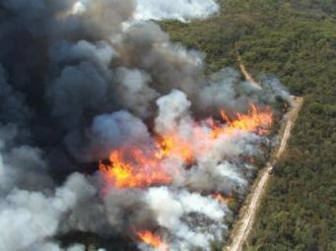
Goal to protect these
from this

Slide 9
Bush Fire Survival Map

Slide 12
OUTCOMES OF THE CPP PROCESS
Community Engagement and Preparedness
Property Inspections
Implementation of APZ and SFAZ (HR Burns)
AIDER program
Mapping and maintenance of Fire Trails
Hotspots program
NSP-enhancement and resilience works
Display of the CPP

Slide 13
CPP’s Completed to Date:
Myola
Bendalong
North Bendalong
Cunjurong Point
Manyana
Berringer Lake

Slide 14
CPP’s to be Completed within 5yrs
Hyams Beach 2017/2018
Sussex Inlet 2017/2018
Currarong 2018/2019
Burrier 2018/2019
Brooman 2019/2020
Shallow Crossing 2019/2020
Yadboro 2020/2021
Budgong 2020/2021
Morton 2021/2022

Slide 15
