Slide 1
CCB Executive Webinar
Starting shortly

Slide 2
Organisational Structure
Presented by Stephen Dunshea Chief Executive Officer

Slide 3
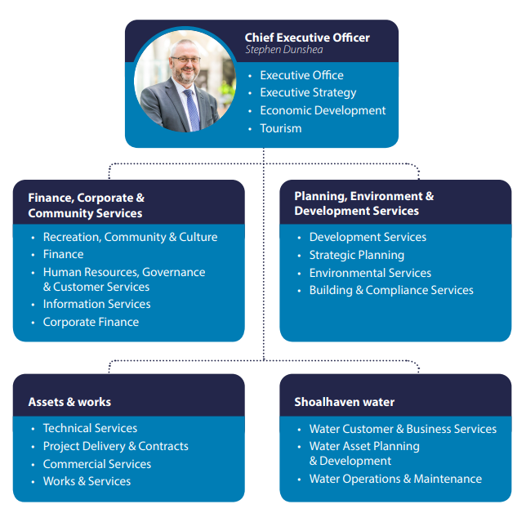
Old Structure
Previously:
Finance, Corporate & Community Service – Acting Director Jane Lewis
Planning, Environment & Development Service – Director Phil Costello
Assets & Works – Director Paul Keech
Shoalhaven Water – Acting Director Robert Horner

Slide 4
Why Change the Structure?
Vacancies existing in two (2) senior staff roles
Director – Finance, Corporate & Community Services
Director – Shoalhaven Water
Opportunity to review these roles
Reviews carried out in 2019 that focussed on Customer Service, DA processing, and Future Directions for the Shoalhaven highlight to me the need to:
Make sure the City and the Council are future ready to grasp opportunities expected to arise from the completion of the highway upgrades – making us more accessible
Harness the opportunity for a fresh approach which had been articulated to me my many in the community – including the business community
Enhance our capability to turn plans into reality
Ensure a strong focus on Strategic Planning and Development Assessment to achieve the best outcomes for the Shoalhaven
Develop a more robust customer engagement strategy and customer experience – recognising both external and internal customers
Improve project management and delivery
Strengthen organisational performance and reporting
Improve communications and community engagement

Slide 5
What is the New Structure?
The following senior staff structure was adopted by Council on 6 August 2020

Slide 6
Who is Who in the New Structure?
Chief Executive Office – Stephen Dunshea
Executive Manager Shoalhaven Water – Robert Horner (Interim)
Director City Services – Paul Keech
Director City Development – Phil Costello
Director City Futures – Robert Domm
Director City Lifestyles – Jane Lewis (Interim)
Director City Performance – Kevin Voegt (Interim)
Manager Media & Communications – Kate Crowe (Interim)
Note:
Interim indicate the position is subject to recruitment
Changes to reporting lines for management and teams is currently underway in consultation with staff

Slide 7
Functions of the New Directorates
City Services
Asset Strategy
Maintenance & Construction
Technical Services
Council Buildings & Property Services
Commercial Services
Waste Services
Bereavement Services
Holiday Haven
Fleet & Mechanical
Natural Areas
Infrastructure
Asset Protection Zones
Environmental Reviews (REFs)
Project Delivery
Parks & Open Space
Energy & Sustainability
Emergency Management
City Development
Development Assessment
Certification
Building Assessment
Compliance
Ranger Services
Animal Management
Environmental Services
Policy
Regulation
Compliance
Weeds
Natural Areas
Waterways
Beaches
Bushland
Ulladulla Service Centre
City Futures
Strategic Land Use Planning
Strategic Infrastructure Planning
Urban Release Areas
Transformational City Projects
City Growth, Advocacy and Tourism
Economic Development
Placemaking & Urban Renewal
Affordable Housing Strategies
Strategic Property Asset Ventures

Slide 8
Functions of the New Directorates
City Lifestyles
Library Services
Arts & Culture
Community Development
Social Planning
Community Capacity Building
Community Resilience Planning
Social & Community Infrastructure Planning
Shoalhaven Swim Sport & Fitness
Operations
Service Provision
Asset Management Planning
Management Committees
Community Well-being and Lifestyle Strategies
Shoalhaven Entertainment Centre
Family Day Care
City Performance
Corporate Finance
Long-term Financial Planning
Procurement & Stores
Information Technology & Smart Cities Initiatives
Customer Service Strategy & Contact Centre
Integrated Planning & Reporting
Corporate Performance Measurement & City projects Monitoring
People & Culture
Legal & Governance
Work Health & Safety
Business Assurance & Risk

Slide 9
Shoalhaven Water
Shoalhaven Water remains Council’s Water Utility and a separate reporting entity with no change to the following existing functions
Water Accounts Business Support
Water Accounts & Business Support
Metering & Services
Projects Compliance & Accounts
Business Operations
Water Asset Planning & Development
Projects Design
Projects Regulations
Projects Development
Projects Assets
Capital Portfolio Operations
Service Provision
Asset Management Planning
Management Committees
Water Operations & Maintenance
Mechanical / Electrical
Waster Operations
Waste-Water Operations

Slide 10
Open for Business
Working and Connecting Safely During COVID
Presented by Jane Lewis

Slide 11
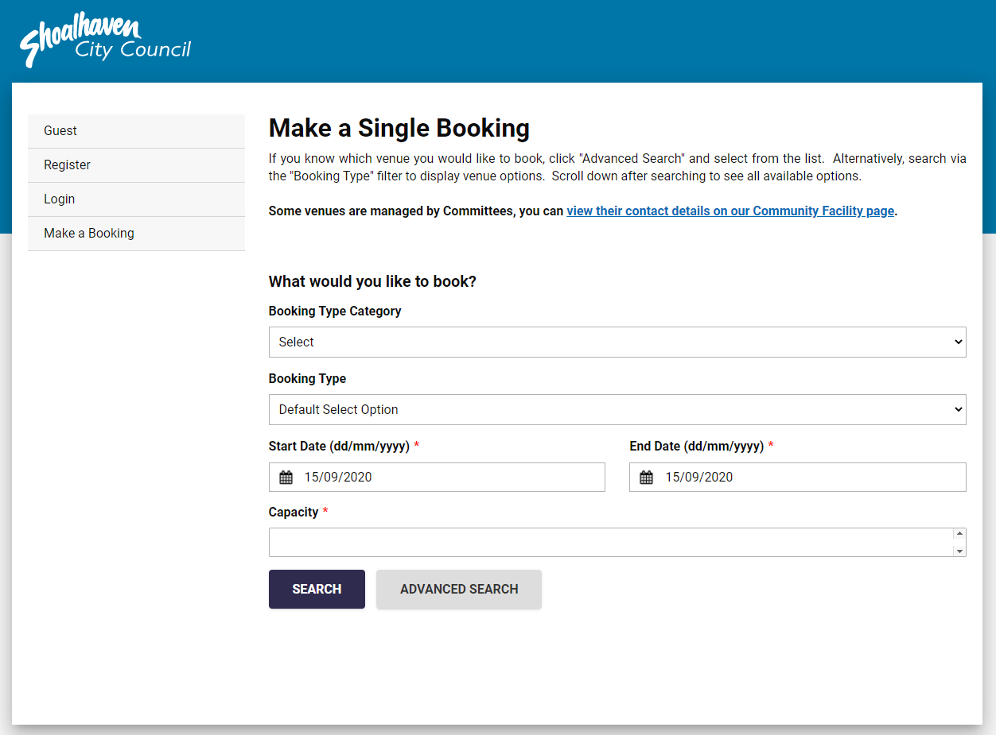
COVID and Business as “New Normal”
Council has:
Supported CCBs since Bushfires/COVID
Frequent phone calls were made to CCBS
Discontinued the regular Familiarity Tours
Moved the CCB Executive Meeting online
Staff are still here to help and support you
Dedicated CCBs page on our website
Online Booking Facility for Community Venues
Notes:
Council has
Supported CCBs since Bushfires/COVID
Community Engagement staff have made phone contact with CCB representatives to:
1. Check how each CCB is going
2. Ascertain if they have been able to hold virtual meetings
3. Check if Council can assist with anything
4. Ascertain current issues for their community
5. Update on the status of the CCB Guidelines
Regular Phone Calls were made to CCBs.
A number of CCBs are holding regular zoom meetings, others have postponed all meetings as members do not have access to technology, many are using email and Facebook to communicate with community members.
Discontinued the regular Familiarity Tours at this time
Moved the CCB Executive Meeting online until such times as we resume face to face meeting and/or onsite meetings.
Please be reassured that staff are still here to help and support you. Staff will make regular phone contact following this meeting we will send out a survey to seek feedback on how we can connect with you effectively, the frequency and what information you are seeking.
There will be an opportunity today to ask questions via the chat and all questions that are asked will be collated into a FAQ’s which will be made available on the dedicated CCBs page along with the minutes. The dedicated CCBS page also includes many helpful resources and Kevin Voegt will be taking you through as part of his presentation where to locate this.
A number of CCB’S use Council community facilities to hold their meetings. The current arrangements are in place:
Online booking system launched on 4 August 2020
Allows registered users to book single or multiple venues at their convenience and via credit card payment
Very positive feedback received since launch
Bookings are being managed online for Council-run facilities and camping. COVIDSafe information is provided during the booking process
Hirers are required to clean surfaces before and after events
Keys / key-packs are disinfected upon return
Management Committee volunteers are minimising personal contact and encouraging enquiries managed by phone
There has been a significant reduction in events at the facilities, however, group activities are gradually returning and some larger events are adapting their format to return.

Slide 12
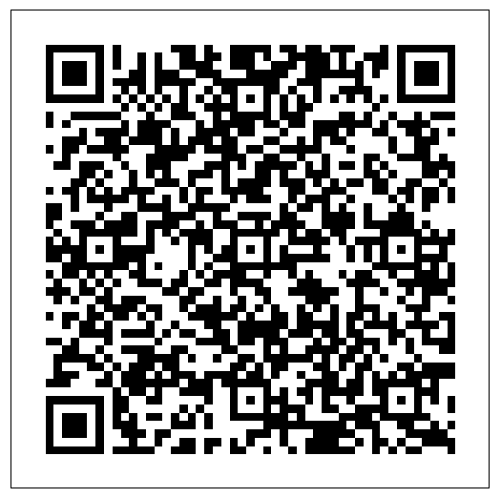
Customer Service and How We Are Working
Observing the most recent advice from NSW Health and Safe Work NSW our businesses and services are registered as COVID Safe.
Relevant areas of Council have registered and implemented a COVID-19 Safety Plan as required by NSW Health
The deputations process has changed
Dedicated page on Council’s website titled Coronavirus (COVID-19) - Community Information including links to NSW Health
Facebook and Web Chat for Customer Service
Notes:
Observing the most recent advice from NSW Health and Safe Work NSW our businesses and services are registered as COVID Safe.
Changes include:
Controlled entry restrictions on numbers in spaces 1 per 4square meters
Social distancing and
Decal stickers on the floor displaying physical distancing requirements
Hygiene practices such as hand sanitiser stations have increased and have been strategically placed at entry and exit points of relevant Council facilities;
Additional and increased frequent cleaning of internal buildings including handrails, lifts and bathrooms
Customers are required to provide their details for the purpose of contact tracing (Preferred option is electronic using a QR code reader).
COVID safe marshals are in place at gyms and cafes and
Sneeze screens have been installed.
46 plans in place across Council, these are for customer service focused areas.
A number of our facilities have been inspected by NSW Health and Safe Work NSW.
The deputations process has changed.
Write or record your submission
Your submission can be either:
A Video or Audio File containing a deputation which lasts no longer than three (3) minutes
A Written submission no longer than four (4) A4 pages in length
When making a submission:
You must refrain from making personal comments or criticisms or revealing any private, sensitive or privileged information
You may not make insulting or defamatory statements
You may not make personal allegations against Councillors and/or staff or be disrespectful. When such statements are made the deputation will not be posted online or made available to Councillors
Submissions must be relevant to the issue on the meeting agenda
There will be no limitation applied to the number of deputations for each item.
Step 2.Please complete the Make a Deputation form and submit by 3.00pm on the day prior to the meeting.
Submissions received by Council prior to the deadline will be made publicly available via YouTube and/or Shoalhaven City Council's Website. Late submissions will not be made publicly available and may not be viewed by Councillors prior to the meeting.
Step 3.Note:
Submissions not fitting the above requirements may be determined by the Chairperson to not be a valid deputation.
Speakers do not have absolute privilege. Any person submitting a deputation who makes any offensive or defamatory remarks about another person may be personally liable for their actions.
Council meetings are not opened to the public in line with OLGs guidelines and restricted numbers are in the Council chambers.
Dedicated page on Council’s website titled Coronavirus (COVID-19) - Community Information including links to NSW Health
Council’s Facebook provides COVID updates and links for customers to complete their transaction online as well as providing Web Chat for Customer Service purposes.
In relation to how operational staff have adapted:
To minimise the movement of workers and to keep teams and plant together, workers remain within their small workgroups or with their work buddy.
Restrictions of vehicle occupants are in place with no more than two workers to travel in one vehicle for essential operational reasons.
Any sharing of plant including vehicles and tools, requires cleaning prior to and after the change-over between workers.
Additional cleaning products, sanitiser, masks and PPE is available to workers as required

Slide 13
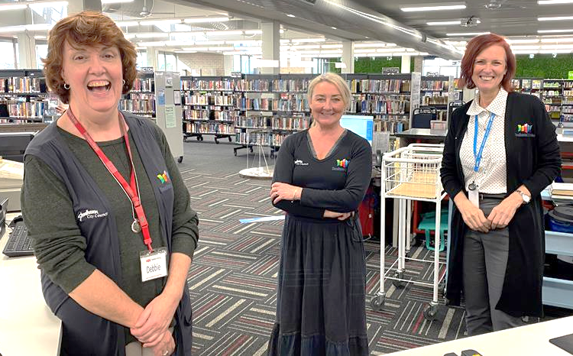
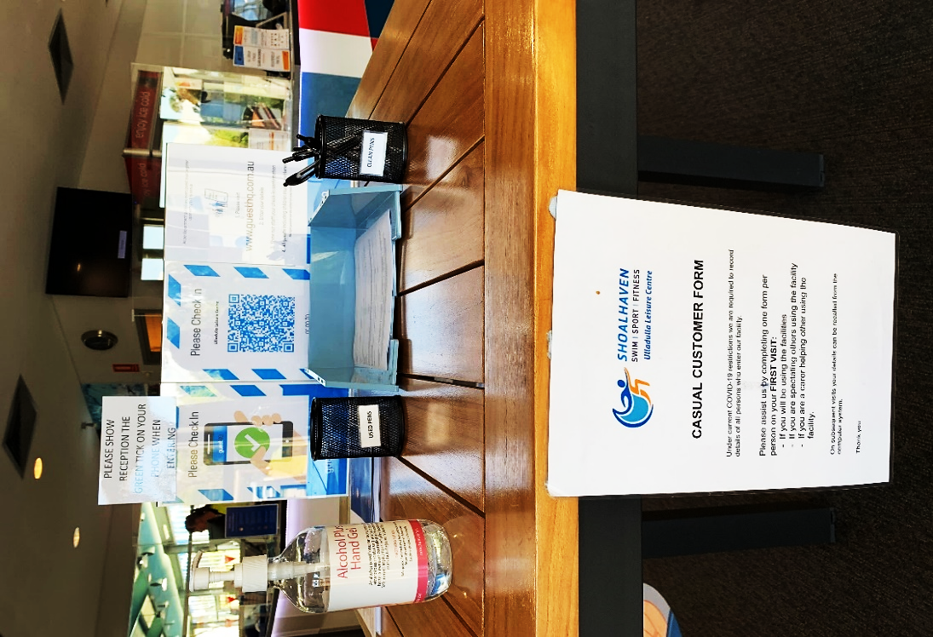
Customer Service and How We Are Working
Notes:
As mentioned, over 46 Council facilities have a COVID-19 Safety plan in place from Council Management Facilities to Shoalhaven Bereavement Services.
The Bay and Basin Leisure Centre was inspected by a NSW Health Inspector and received excellent feedback with their gym equipment spaced 1.5 metres apart, sign in procedures, hygiene measures and increased cleaning measures in place
To keep staff and customer safe, bookings for the animal shelter are by appointments only (no walk in’s) with a maximum number of 4 customers in at one time, with the meeting is area cleaned before and after each visit. Customers are required to register their details for the purpose of contact tracing.
Libraries
Items are quarantined and cleaned prior to returning to shelves
Toys have been removed from the children’s areas
Signage in place to promote hand and general hygiene, high touch areas are frequently cleaned
Maximum number of people permitted
Animal Shelter adoption numbers have never been so low, there is currently 1 dog available for adoption and no long-term animals in care. The dog pictured above has already found his forever home.

Slide 14
Council’s District Engineers
There are four District Engineers
The areas they represent are South, Bay and Basin, Nowra Central and North (of the Shoalhaven River)
The Council contact for each area is:
District Engineer South - troy.punnett@shoalhaven.nsw.gov.au
District Engineer Basin - phil.critchley@shoalhaven.nsw.gov.au
District Engineer Central - melissa.dunn@shoalhaven.nsw.gov.au
District Engineer North - jatish.singh@shoalhaven.nsw.gov.au

Slide 15
New Directorate – City Lifestyles
The City Lifestyles Directorate and its functions include:
Community and Recreation
Library Services
Arts and Culture
Swim Sport and Fitness
Shoalhaven Entertainment Centre
Development Contributions Coordinator
The following functions will be joining City Lifestyles Directorate:
CCB Liaison
Community Recovery
Community Resilience
Notes:
The City Lifestyles Directorate is new and its Functions include:
Community and Recreation
Library Services
Arts and Culture
Swim Sport and Fitness
Shoalhaven Entertainment Centre
Development Contributions Coordinator
Moving forward with the new directorate the CCB Liaison and Community Recovery and Resilience functions will be joining City Lifestyles. As this takes shape we will provide the CCBs with regular updates, however, rest assured it is still business as usual and we look forward to continuing to partner with our CCBS.

Slide 16
City Performance
Presented by Kevin Voegt

Slide 17
The New Shoalhaven City Council Website

Slide 18
About the Project
Over the past 12 months Shoalhaven City Council has undertaken a complete rebuild of Council’s digital platform and presence.
The new website has been completely redesigned and rebuilt to deliver a more engaging and easier to use digital platform for the Shoalhaven community
The launch of the new website is an important milestone in Council's commitment to a greater customer focus and improved community engagement and digital governance
Notes:
The new website has been completely redesigned and rebuilt to deliver a more engaging and easier to use digital platform for the Shoalhaven community. By taking advantage of current and emerging website technologies, this new website allows Council to provide improved information and digital services both now and into the future and ensures we keep pace with other Councils both in NSW and across Australia.
The launch of the new website is an important milestone in Council's commitment to a greater customer focus and improved community engagement and digital governance.

Slide 19
Goals of the New Website
Focus on our key activities and services
Prioritise what matters to users, based on data
Provide simple, clear and actionable information about the services and operations of Council
Promote two-way communications that empower the community
Deliver a modern, inviting and accessible website
Continuously test user experience and ensure the website has the ability to adapt and change as we learn about our Community needs
Rebuilding the website was a collaborative effort, with many sections of Council being involved in the content development process
Notes:
Focus on the key activities and services of Council
Prioritise what matters to users, based on data
Provide simple, clear and actionable information about the services and operations of Council to the residents and rate payers of Shoalhaven City Council
Promote two-way communications that empower the community
Deliver a modern, inviting and accessible website that will become the backbone of Council’s digital interaction with the community
Continuously test user experience and ensure the website has the ability to adapt and change as we learn about our Community needs

Slide 20
Thank You
Five CCB’s were invited to comment on Council’s new website prior to launch. This feedback was very helpful for Council.
Thank you to the following CCB’s for your assistance:
Currarong
Huskisson
Lake Tabourie
Shoalhaven Heads
Sussex Inlet
We still need ongoing feedback to continuously improve…

Slide 21
Website Introduction

Slide 22
Projects & Engagement
You will find a vast range of information available on this page, such as:
Major Projects & Works
Get Involved Shoalhaven
CCB’s
Road Works – Current & Upcoming (with interactive map)
Newsletters (subscribe and stay informed)
Council Meetings
Notes:
To stay informed about our major projects and works, community participation and volunteering opportunities, road works, Council meetings etc. visit:

Slide 23
Reporting a Problem
There are three ways to report a problem:
Online
By phone
In person
Shoalhaven City Council has no affiliation with Snap/Send/Solve Pty Limited.
Council would prefer that all issues are reported using the “Report a Problem” page on Council’s website.

Slide 24
How to Report a Problem Online?
Roads
Trees on public land
Water Supply & Sewer Services
Animals
Rubbish, Bins & Illegal Dumping
Stormwater & Drains
Footpaths & Pavements
Graffiti & Vandalism
Noise
Parks & Council Facilities
Other

